Slide 1

TOWARDS A HYBRID DISCRETE EVENT SIMULATION AGENT-BASED MODEL FOR THE TEXAS STATE MENTAL HOSPITAL SYSTEM
Maria Tomasso
met48@txstate.edu

Slide 2

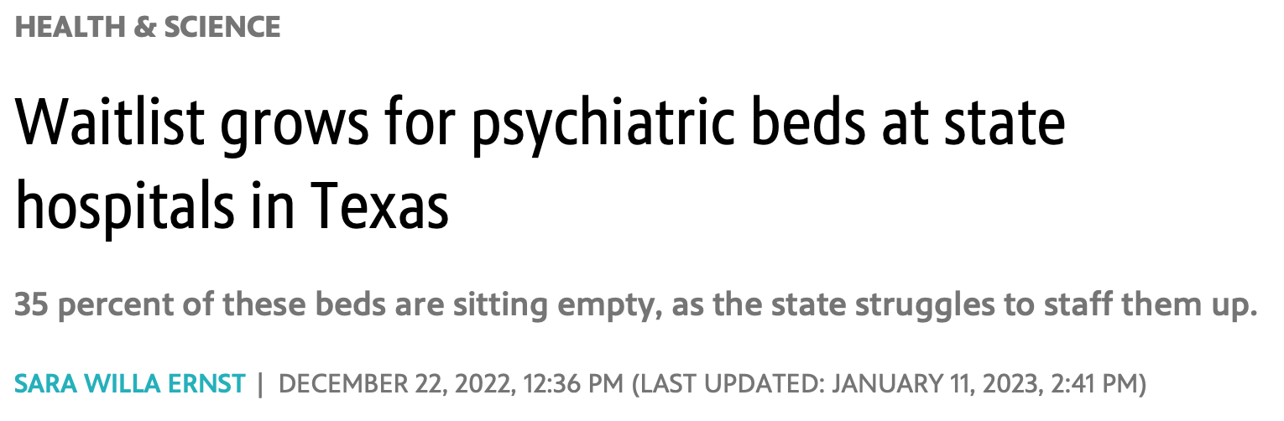
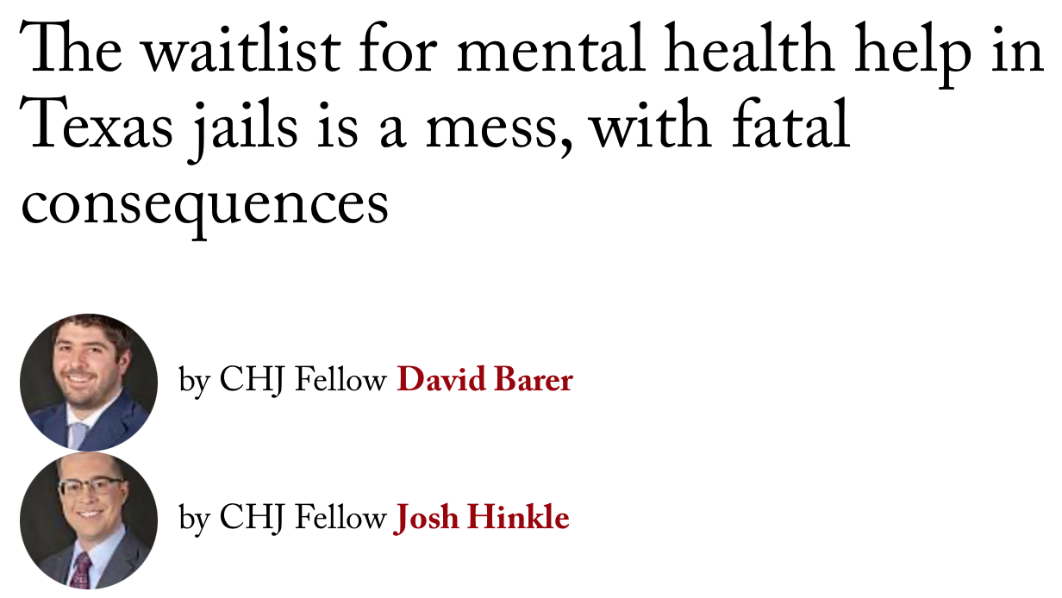
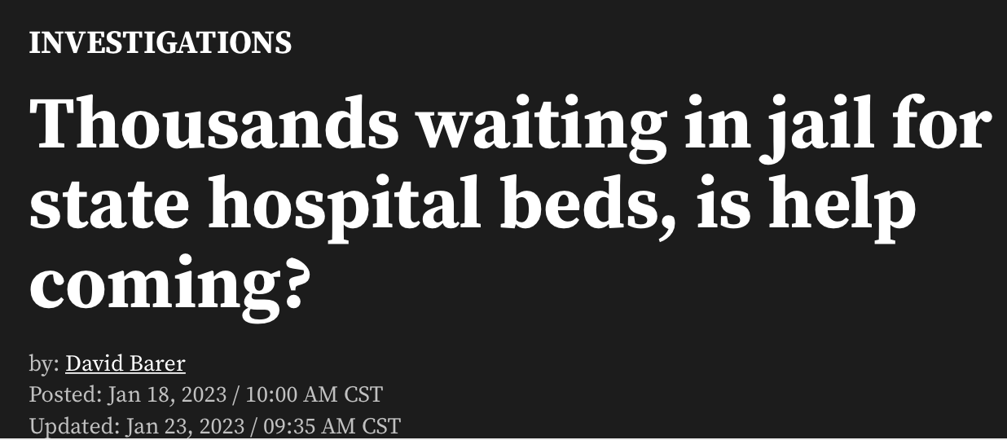
BACKGROUND
Notes:
In Texas, state mental hospitals serve a vital role in our criminal justice system. These hospitals treat patients who have been found not guilty by reason of insanity or who must be restored to competency before standing trial. Unfortunately, in recent years higher demand and low staffing levels have caused long waitlists to develop. While patients wait for a bed to become available, many must wait in jail, during which times their conditions can worsen and in some cases, they die. This problem has received a lot of legislative attention in the past couple of years, but the waitlists have continued to grow

Slide 3
GOALS
This work aims to address the waitlist crisis in the state mental healthcare system by:
Building a hybrid DES-ABM model of the system and training it with real data.
Using the model to test the effects of capacity expansion on the waitlists.
AVAILABLE DATA
The number of state mental health hospitals serving adults in Texas [1]
The number of beds per hospital and average length of stay (LOS) per hospital [1]
The ratio of civil admits to forensic admits [1]
The number of patients added to, removed from, and on the waitlist at each quarter from 2020-2023 [2,3,4,5,6]
Notes:
(Goals – read verbatim)
Available data – data collection was probably the most challenging part of this project. Data was mainly available in aggregate,

Slide 4
MODEL
Timesteps represent 5 days and the model is run for 216 timesteps - equivalent to Q1 2020 – Q4 2023.
New patients are added to the model at each timestep based on historical data.
Hospitals will admit patients until they are full. When all hospitals are full, new patients are added to the shortest waitlist. Beds become available as patients are discharged.
At each timestep, the total number of waitlisted patients is recorded.
The model is implemented in Python 3.10.9.

Slide 5
INITIALIZATION AND CALIBRATION
The model in initialized with the number of hospitals, number of available beds per hospital, and waitlist length at the end of 2019.
Approximate Bayesian computation was used to estimate the distributions of the length of stay for civil admits, short-term forensic admits, and long-term forensic admits.
Calibration success was determined by comparing the simulated waitlist lengths with the historical waitlist lengths.

Slide 6
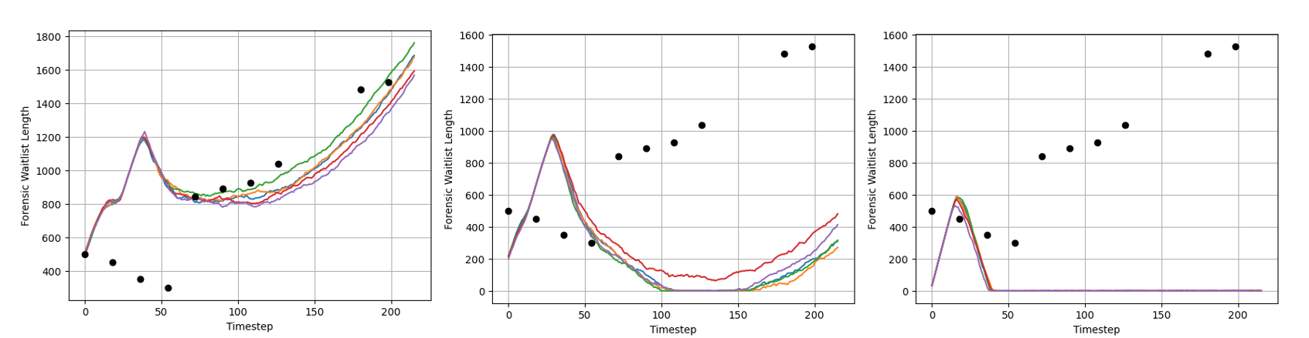
RESULTS
The forensic waitlist lengths for 5 runs of the tuned model are shown under 3 scenarios: (left) online number of beds per facility is as reported in June 2022; (middle) each facility uses 80% of their total beds or the percentage reported in June 2022, whichever is higher; (3) each facility uses all available beds.

Slide 7
NEXT STEPS
As Texas grapples with inflated wait times, DES-ABM modeling, in collaboration with legal and psychiatric experts, provides an avenue to predict demand on the state mental health system and test the effect of resource allocation strategies on simulated waitlists.
The next phase of this project will involve requesting more in-depth patient population data from the Texas Department of State Health Services, enabling more comprehensive modeling

Slide 8
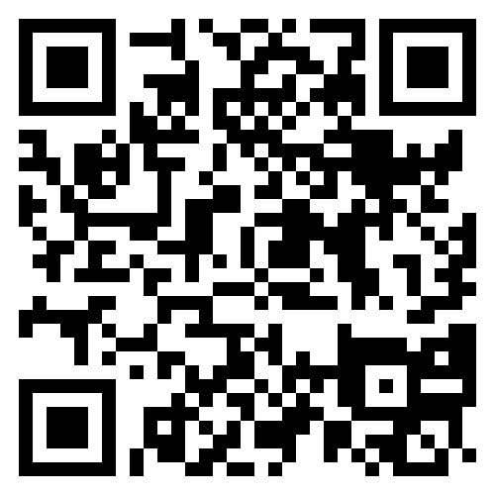
QUESTIONS?
Email: met48@txstate.edu
Code and data: https://github.com/MariaElise-T/WSC_2023
Citations
The State of Texas Legislative Budget Board. 2022. “State Hospitals: Mental Health Facilities in Texas.” Legislative Budget Board Staff.
Texas Health and Human Services. April, 2020. “Semi-annual Reporting of Waiting Lists for Mental Health Services.” Health and Human Services Commission.
Texas Health and Human Services. October, 2020. “Semi-annual Reporting of Waiting Lists for Mental Health Services.” Health and Human Services Commission.
Texas Health and Human Services. April 2021. “Semi-annual Reporting of Waiting Lists for Mental Health Services.” Health and Human Services Commission.
Texas Health and Human Services. November 2021. “Semi-annual Reporting of Waiting Lists for Mental Health Services.” Health and Human Services Commission.
Texas Health and Human Services. May 2023. “Report on Waiting Lists for Mental Health Services.” Health and Human Services Commission.

